Slide 1
HTML & CSS3

Slide 2
What you will learn?
Learn HTML basic elements
HTML5 Semantic Elements
CSS Styles
CSS3 Responsive Design
CSS3 Animations

Slide 3
What you will need?
PC with internet
Code Editor
Notepad++
Sublime Text
VS Code
Brackets
Chrome/ Firefox/ Opera(Browser)

Slide 4
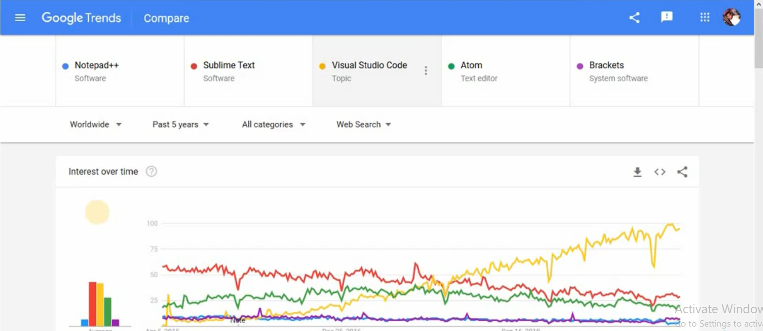
Which code editor to choose?

Slide 5
Installing VS Code
https://code.visualstudio.com/download

Slide 6
First Code:
Open VS Code
Write Hello World
Writing code without proper mark up is not good. So, we need a document structure.
Shortcut: write html5 and select the dropdown in the vs code. Entire html structure will come.

Slide 7
JAVASCRIPT
Javascript is the programming language of the web.

Slide 8
Javascript & Java
JAVA | JAVASCIPT
Programming language | Browser based programming language
Needs an IDE | Works with any latest browser
Used for software development | Works fine with any code editor
Needs a compiler to run | Simple and easy to start

Slide 9
Where is Javascript used?
Applications
Acrobat
Photoshop
Other popular applications
Server side programming
Node.js
Google Apps Script

Slide 10
History of Javascript
Developed in 1995 (LiveScript)
Javacsript Netscape(1996) – IE3 Jscript
Ecma script (1997)
Ecma script 3 (1999)
ES5 – 2009
ES6 & ES7(still under development)

Slide 11
Prerequisites
HTML & HTML5
CSS & CSS3
HTML
CSS
Javascript
Content Structural
Behavioural
Style Presentation

Slide 12
Code Hello world in Javascript

Slide 13
Do’s & Don’t
alert(“Hello, world!”);
Alert(“Hello, world!”);

Slide 14
Statements in Javascript
Change color of heading
Calculate age
Move an image
Hide a menu
Alert some “important message”

Slide 15
Statements are written in 1 line
User use multiple line to declare your statement
alert(“Hello, world!”);
alert(“Another message!”);
alert(“Warning message!”);

Slide 16
Whitespace in Javascript
Whitespace in javascript is completely fine .
It is case sensitive but not space sensitive.
alert(“Hello, world!”);
alert(
“Hello, world!”
);
alert( “Hello, world!” );
alert(“Hello, world!”);

Slide 17
Comments In Javascript
// commenting in javascript
/*
block comment
*/

Slide 18
Placements of javascript code
Either in the same header/ footer section. Preferebly footer section.
Or in a separate js file.

Slide 19
Variables
Email: someone@123.com
DOB: 07/09/1999
Phone Number: 0123456789
Age: 32
Address: #100, Someplace, Bangalore 560011

Slide 20
Creating Variables
var name, email, phone
var year
var customerEmail
var todaysDate
var box
var x
var 99boxes
var boxes99
Variables can contain:
letters
Numbers
_
$

Slide 21
Variable datatypes
Integer
Floating point
String
Boolean
Array
Date
object

Slide 22
Setting variable
Var box=99;
Var box = “Hello World”;
Var box = ‘Hello World’;
Var box= true;
Var box= false;

Slide 23
Conditions in Javascript
If(condition)
{
//code goes here
}

Slide 24
Programming guidelines
( Parentheses )
[ Brackets ]
{ Braces }

Slide 25
True or False Condition
If(x<50)
{
// code goes here
}

Slide 26
Simple operations
If ( a == b)
{
//do something
}
a == b
a > b
a != b
a === b

Slide 27
Extended Conditions
If ( something is true )
{
// do this
}else
{
// do something else
}

Slide 28
Nested Conditions
If ( something is true )
{
// do this
if( something is true inside ){
// do something nested
}
} else{
// do something else
}

Slide 29
Operators in Javasccipt
Arithmetic Operators
Addition ( + )
Subtraction ( - )
Multiplication ( * )
Division ( / )

Slide 30
Assignament operator
Assignment operator ( = )
result = a + b

Slide 31
Assignment operator
Assignment operator ( = )
+=
score = score+10
-=
score += 10
*=
/=

Slide 32
Operator Precedence( *, + )
result= 10 + 10 * 5 ;
result = ( 10 + 10 ) * 5 ;
60
50
100
20 * 5

Slide 33
Comparison operator
a = 5;
b = 10;
If ( a = b)
{
// true
}
If ( a == b)
{
// false
}
If ( a === b)
{
// false
}

Slide 34
Comparison operator
a = 5;
b = 10;
If ( a!= b )
{
//true
}
If(a !== b )
{
//true
}
Strict comparison operator

Slide 35
Logical AND / OR
Comparing several things
If ( a === b && c == d) {…}
If ( a === b || c == d) {…}

Slide 36
Modulus
var year = 2003;
var remainder = year % 4; //remainder is 3

Slide 37
Increment & Decrement
a = a + 1;
a += 1;
a++;
++a;
a = a - 1;
a -= 1;
a--;
--a;

Slide 38
Postfix & Prefix
var a = 5;
alert( ++a);
6
var a = 5;
alert(a++);
5

Slide 39
Ternary operator
var playerOne =500;
var playerTwo = 600;
var highScore;
If (playerOne > playerTwo )
{
highScore = playerOne;
}else{
highScore = playerTwo;
}
var highScore= (palyerOne > playerTwo ) ? palyerOne : palyerTwo;

Slide 40
Loops in javascript
While loop
var a = 1;
If ( a < 10)
{
// do something
}
var a= 1;
while (a < 10)
{
//do something
a++;
}

Slide 41
Do while Loop
var a= 1;
while (a < 10)
{
//do something
a++;
}
var a = 1;
do
{
// do something
a++;
}while(a < 10);

Slide 42
For loop
var a= 1;
while (a < 10)
{
//do something
a++;
}
for ( i=1; i<10; i++)
{
//do something
}

Slide 43
Break
for( i=1 ; i<10; i++ )
{
//do something
if(i == 5)
{
break;
}
}

Slide 44
Continue
for( i=1 ; i<10; i++ )
{
//do something
if(i == 5)
{
continue;
}
}

Slide 45
Functions in javascript
A JavaScript function is a block of code designed to perform a particular task.
A JavaScript function is executed when "something" invokes it (calls it).

Slide 46
Where to Declare functions
Define your functions before you call them.
myFunction();
function myFunction()
{
console.log(‘Do something’);
}
function myFunction()
{
console.log(‘Do something’);
}
myFunction();

Slide 47
Functions with parameters
function myFunction(x,y,z)
{
var a = x+y+z;
console.log(a);
return a;
}
myFunction(2 , 3 , 4 );

Slide 48
Variable Scope
function myFunction()
{
var a = 25; //local scope
console.log(a);
}
myFunction();
a=25; //global scope
function myFunction()
{
console.log(a);
}
myFunction();

Slide 49
Function mismatch
function myFunction( x, y, z )
{
//do something
}
myFunction(2 , 3 );
//z is undefined
function myFunction( x, y, z )
{
//do something
}
myFunction(2 , 3, 4 , 5 );
//5 is ignored

Slide 50
Creating Arrays
Hold multiple values
0 based index
[0] = One
[1] = Two
[2] = Three
someData[0] = One
someData[1] = Two
someData[2] = Three
var someData = [‘One’ , ‘Two’, ‘Three’];
var someData = new Array(‘One’ , ‘Two’ , ‘Three’);

Slide 51
Array Methods
var someData = [10, 20, 30, 40, 50];
var someData = [10, 20, 30, 40, 50];
var newSomeData = someData.reverse();
.join();
.sort()

Slide 52
Numbers in javascript
All numbers are 64 bit floating point numbers.
20 and 20.0 is same in javascript.

Slide 53
Additon vs Concatenation
var a= 5;
var b = 5;
console.log(a + b );
//addition 10
var a= “5”;
var b = “5”;
console.log(a + b );
//joining 55
var a= 5;
var b = “5”;
console.log(a + b );
//joining 55
var a= 5;
var b = 5;
console.log(a * b );
//NaN

Slide 54
Not a number
var a=“ 55”;
var myNumber= Number(a); //try to convert it to a number
if (isNaN(myNumber)){
console.log(“its not a number”);
}

Slide 55
Using Math object
var x = 200.6;
var y = Math.round(x); //201
var a=10, b = 20, c = 30;
var biggestNumber = Math.max(a, b, c);
var biggestNumber = Math.min(a, b, c);
Math.PI Math.random() Math.sqrt()

Slide 56
Strings in javasript
var myString = “A simple string”;
var myString = ‘A simple string’;
var myString = “He said “that’s fine” , and left”;
var myString = “He said \“that\’s fine \” and left.”;

Slide 57
Dates in javacsript
var today =new Date(); //current date and time
//year month day
var y2k = new Date(2000, 0, 1);
//year month day hours min sec
var y2k = new Date(2000, 0, 1, 0, 0, 0);

Slide 58
Methods of Date Object
var today = new Date(); //current date and time
today.getMonth();
today.getFullYear();
today.getYear(); //deprecated
today.getDate();
today.getHours();
today.getTime();

Slide 59
Set Methods
var today =new Date();
today.setMonth(2); //march
today.setFullYear(2000);
today.setDay(0); //beginning of the day

Slide 60
Objects in javascript
Array
Date

Slide 61
Creating an Object
var playerName = “john” ;
var playerScore = 1000;
var playerRank = 1;
var player1 ={
name: “John“,
score: 1000,
rank: 1
}
player1.name;
palyer1.score;
palyer1.rank;
var player2 ={
name: “Smith“,
score: 5000,
rank: 2
}
player2.name;
palyer2.score;
palyer2.rank;

Slide 62
OOP with Javascript
var player1 ={
name: “John“,
score: 1000,
rank: 1
};
var player2 ={
name: “Smith“,
score: 5000,
rank: 2
};
function playerDetails()
{
//display info for each palyer
console.log(this.name + “,” + this.rank + “,” + this.score);
}
player1.logDetails = playerDetails;
player2.logDetails = playerDetails;
player1.logDetails();
player2.logDetails();

Slide 63
DOM in Javacscript
What is DOM?
DOM means Document Object Model
Everything inside a page object is a dom.

Slide 64
DOM
html
head
body
title
h1
p
ul
li
li
li

Slide 65
What can you do with DOM
get the title text
get second paragraph
set css
get names of tags
get all li elements in a ul list
move an image position
add some click functionality
create new elements

Slide 66
Nodes and Elements
html
Node.ELEMENT_NODE == 1
Node.ATTRIBUTE_NODE == 2
Node.TEXT_NODE == 3
head
body
<ul id= “some_thing”>
<li>One</li>
<li>Two</li>
<li>Three</li>
</ul>
title
h1
p
ul
text
text
text
li
li
li
text
text
text

Slide 67
Get an Element Node
The object has to be unique
Use: document.getElementById(“some_id”);
Use: document.getElementByTagName(“a”);
.nodeType .innerHtml [which usually works with document.getElementById(“some_id”)]

